Slide 1
Wednesday, October 19, 2016
Write In Your Agenda:
Write In Your Monitoring Log:
CW:
Putting It All Together Poster
HW:
Need donations of graham crackers and vanilla pudding cups.
Response to Warm-Up:
What are the 3 types of plate boundaries, and what happens at each boundary?
You will need:
Pencil
New Monitoring Log (pink)

Slide 2
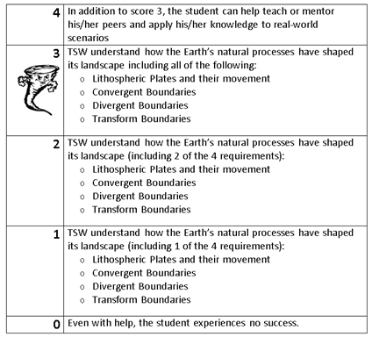
Learning Goal and Scale
TSW understand how the Earth’s natural processes have shaped its landscape (including Lithospheric Plates and their movement, Convergent, Divergent, and Transform boundary landforms).

Slide 3
Take the quiz.
Hand in your quiz and privacy folder.
Read pages 162-168 and complete guided reading sheets.

